Slide 1

Software Engineering Processes SOEN 6011
Prof. Dr. Kamthan Summer 2020
GitHub URL: https://github.com/Saicharanduduka/SOEN-6011-TEAM-D SESTOPIA URL: http://sestopia-d.epizy.com/?i=1
Team D - SESTOPIA

Slide 2
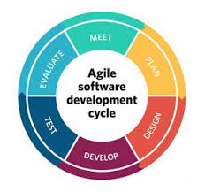
Development Process:
1st iteration: Skills and content.
2nd iteration: HTML Structure.
3rd iteration: CSS and JavaScript.
4th iteration: PHP + Database.

Slide 3
Risks
JavaScript.
User agents.

Slide 4
Challenges
Design.
Cooperation.
Time management.
Quality & Testing.

Slide 5
Lessons Learnt.

Slide 6
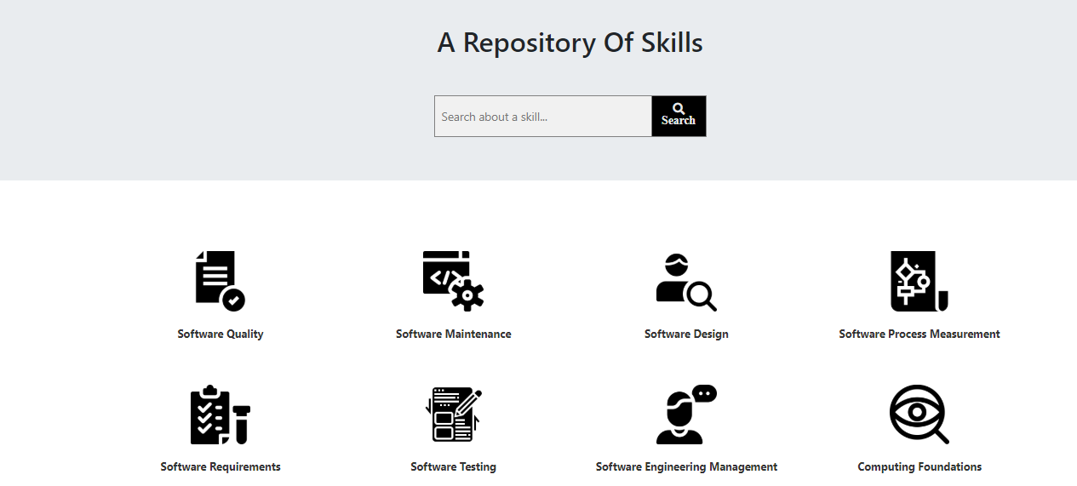
SESTOPIA User Interface (UI)

Slide 7
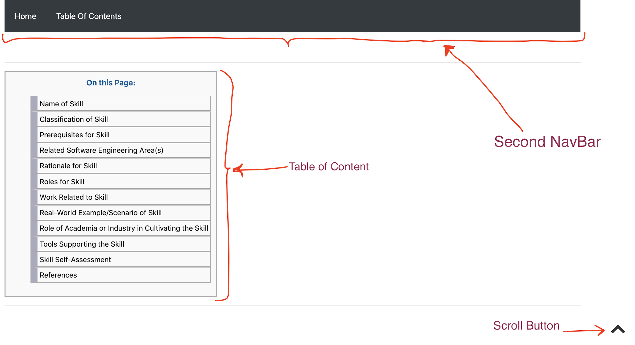
Navigability

Slide 8

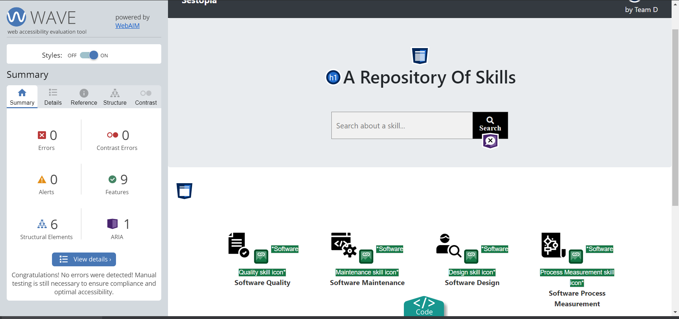
Accessibility

Slide 9
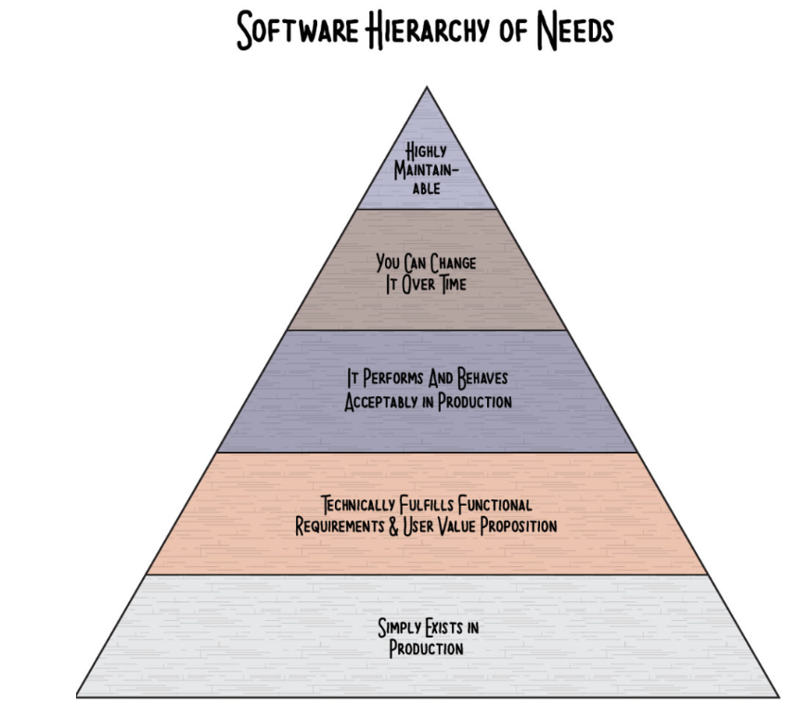
About Development.

Slide 10









Tools
Technology

Slide 11
Introspective Improvements.
Team:
Version Control.
Brain Storming and input.
Project:
Better graphical design.
Learn manual testing on guidelines.
Auto text completion and suggestion.
Location highlight.

Slide 12
Acknowledgements
We would like to acknowledge and thank:
Professor Dr. Kamthan for explanations on the project and correlation with course material.
Our TA’s for their continuous guidance and support via P.O.D sessions and email.

Slide 13
References
[1] https://www.potential.com/articles/project-scope/
[2] https://www.pmi.org/learning/library/five-elements-process-oriented-project-6946
[3] https://en.wikipedia.org/wiki/HTML
[4] https://en.wikipedia.org/wiki/Font_Awesome
[5] https://blog.lucidmeetings.com/blog/how-to-lead-a-successful-project-retrospective-meeting
[6] http://s3.sitepoint.com/examples/git-project-changes.pdf

Slide 14
Thank you

